Slide 1
NEXTHIKES IT SOLUTIONS
Bike Sharing Demand Analysis Project Using Excel
By – Ankita Babar

Slide 2
Introduction:-
We have multiple datasets related to bike sharing data.
Each dataset contains different information such as:
Dataset 1: Date, Temperature, Humidity, Weather
Dataset 2: Hourly rental count
Dataset 3: User type (Casual / Registered)
The goal is to merge them into one Master Dataset for analysis.

Slide 3
Dataset Description
Sources: 3 raw datasets (Day, Hour, Weather data) Steps: 1️⃣ Merge 1st & 2nd datasets → Intermediate data 2️⃣ Merge with 3rd dataset → Master dataset (1000 rows) Main Columns:
dteday, hr, season, weathersit, temp, humidity, windspeed, casual, registered, cnt

Slide 4
Dataset Integration Process
Two initial datasets, Dataset:- 1 and Dataset:-2, are merged.
The result of the merge is a new dataset, Dataset:3.
Dataset :- 3 is then appended to a Master Dataset
Dataset:-1
Dataset:-2
Merge:-1
Dataset:-3
Append
Master Dataset

Slide 5
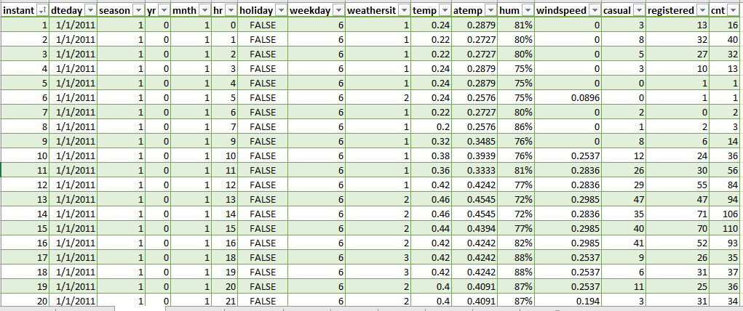
Step 1 – First Merge
Content:
We use a common column (key) like dteday or instant to merge.
In Excel → use functions like VLOOKUP, INDEX + MATCH, or Power Query → Merge Queries
Result: A new merged dataset combining temperature, humidity, and count.

Slide 6
Merge with Dataset 3
Heading: Step 2 – Add third dataset
Content:
Merge the newly combined dataset (from Step 1) with Dataset 3.
Again use the same unique key column (dteday or hr).
Use Power Query → Merge Queries or VLOOKUP.
Result: Final Master Dataset ready for analysis.
Visual: 3rd dataset joining with previous → “Master Dataset” box

Slide 7
Analysis Ready
Heading: Ready for Analysis
Points:
After merging, the Master Dataset can be used for:
Hourly analysis (Rush Hours)
Weather impact on rentals
Weekday vs Weekend demand
Now we can create Pivot Tables and Charts in Excel.

Slide 8
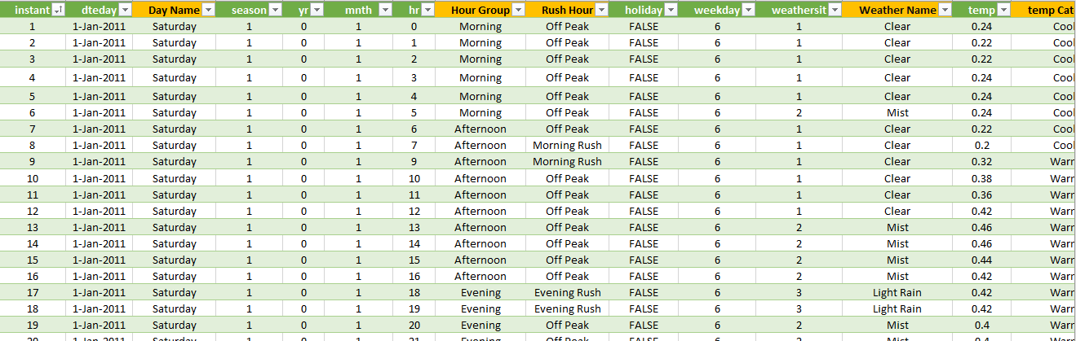
Final Master Dataset
Heading: Master Dataset Overview
Mention:
Total rows (e.g., 1000 entries)
All missing values handled
Ready for Pivot Tables and Charts

Slide 9
Tools & Functions Used
Tools:
Excel Power Query
Pivot Table & Pivot Chart
Slicers & Timelines
Functions Used: VLOOKUP(), INDEX(), MATCH(), IF(), SUMIFS(), WEEKDAY()

Slide 10
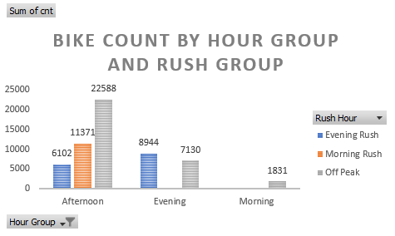
Bike count by Hour Group and Rush Group
Overview :-
This chart shows the total number of bike rentals during different times of the day, divided into morning ,Afternoon , and Evening , and categorized by Rush hours periods .
Fig :- Bike count by Hour Group and Rush Group

Slide 11
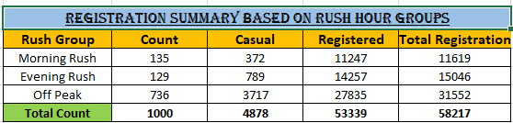
Registration Summary Based On Rush Hour Groups
The table provides a summary of the registrations categorized by rush hour groups.
Total Registrations : The total number of registration is 58,217.
Registration Types : These registrations are divided into two types : 4,878 Casual and 53,339 Registered.

Slide 12
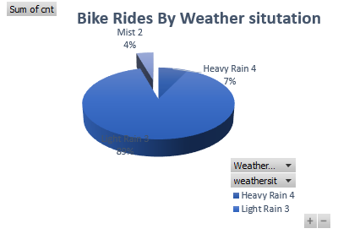
Bike Rides By Weather Situtation
This pie chart ,displays the distribution of bikes rides based on different weather condition
Heavy Rain 4 : Represents 7% of the total bike rides.
Mist 2 : Represents 4% of the total bikes rides.
Light Rain 3 : Represents 89% of bike rides occurred during weather condition ,which is categorized as light rain.
Fig :- Bike Rides By weather Situation

Slide 13
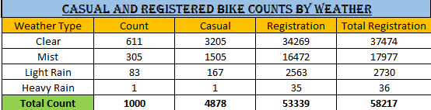
Casual And Registered Bike Counts By Weather
This table has the highest total rentals (both casual and registered).
Clear weather has the highest total rentals(both casual and registered).
Mist and Light Rain conditions show moderate rentals.
Heavy Rain has the lowest count , indicating fewer users ride in bad weather.
Overall , registered users are consistently higher then casual user across all weather types .

Slide 14
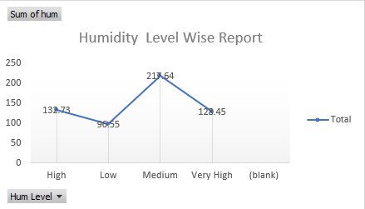
Humidity Level Wise Report
This line graph shows the sum of humidity for different humidity levels
Low humidity has the highest sum at 216.4.
High humidity has a sum of 132.73.
Very High humidity has a sum of 128.45.
Medium humidity has the lowest sum at 96.55.
Fig : Humidity Level Wise Report

Slide 15
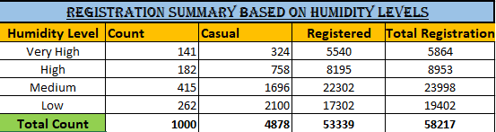
Registration Summary Based On Humidity Levels
The data broken down by four humidity levels :Very High, High, Medium , and Low. For each level ,the table shows the count of “casual and Registered” registrations ,as well as a Total count..

Slide 16
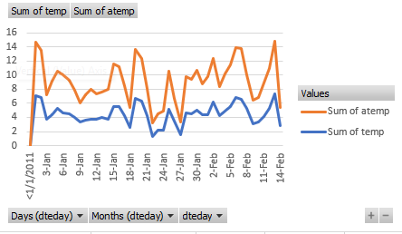
Sum of temp and atemp dteday wise
Chart Type : Line Graph
Variables : sum of temp – represented by the blue line and ,Sum of atemp - represented by the maroon line .
Timeframe : The data is plotted for a period of several weeks, from early January to mid-February
Key Observation : Both variables shows daily fluctuations, with sum of atemp generally being higher than sum of temp throughtout the period
Fig – sum of temp and atemp dteday wise

Slide 17
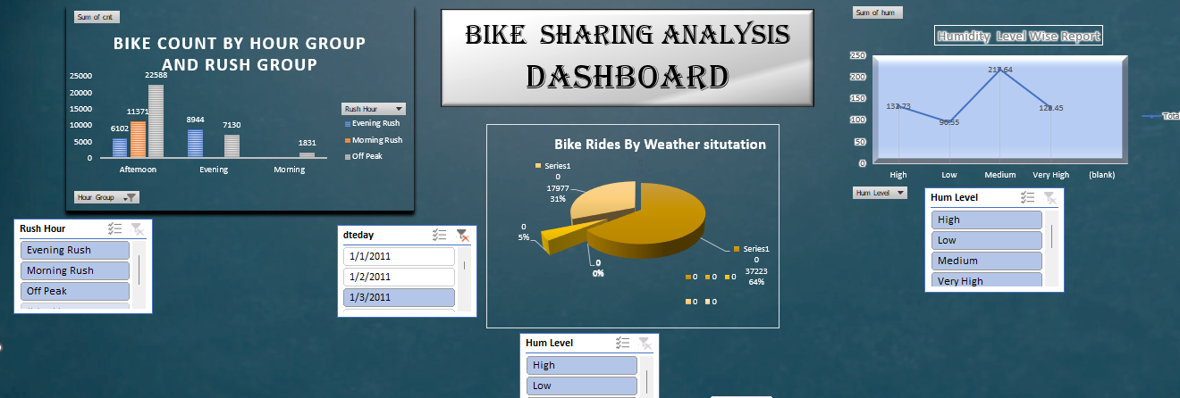
Bike Sharing Analysis Dashboard

Slide 18
Overview:
This dashboard presents a visual summary of bike sharing data, including trends by hour, rush hour, weather situation, and humidity levels.
The analysis helps to identify usage patterns and demand fluctuations throughout the day.

Slide 19
Key Insights
Peak Hours: Evening rush shows the highest bike count, followed by morning rush hours.
Weather Impact: Clear weather conditions see the maximum number of rides.
Humidity Trends: Medium humidity levels correspond to higher ride counts compared to high or low humidity levels.
Usage Patterns: Afternoon hours contribute the most to total rides.

Slide 20
Conclusion
Weather and time strongly affect bike-sharing demand
Data cleaning & visualization helped uncover usage patterns
Insights can help companies plan bike availability efficiently
Excel is a powerful tool for data analysis & dashboarding

Slide 21
Tools used : Microsoft Excel, PowerPoint
Thank you… !

